Slide 1
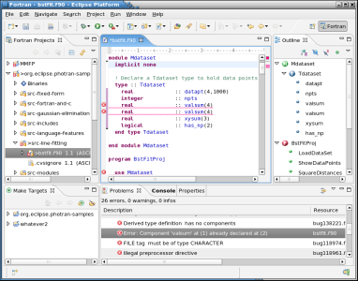
Use of an IDE

Slide 2
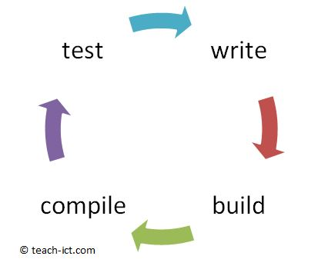
Integrated Development Environment(IDE)
Writing a computer program involves a number of stages
A typical code project involves going around a write -> build -> compile -> test loop as the programmer builds up the program.
A small chunk of the code is written then tested.
Once that bit works another chunk of code is written and tested.

Slide 3
IDE
For larger programs, there may be many source code files, the 'build' phase combines them together ready for the next stage.
The source code is compiled and then tested.
Then the cycle starts again for the next chunk of programming.
Each stage needs a different set of tools and it can be really awkward and slow to move from one tool to another.
The solution is an application called an IDE - Integrated Development Environment.

Slide 4
IDE Features
Typical IDE features include:
Project(s) explorer
A window that shows all project files and folders
Asset library
A window that lists all the assets such as images, sound, media files in the project.
It may also allow you to duplicate, edit and delete assets or drag them in from another project

Slide 5
IDE Features
Editor
Helps you to write code efficiently and easily with aids such as colour coded highlighting, auto-completion and brace matching.
Colour coding text and syntax highlighting can be used to check code is correct.
Auto-complete allows you to view and use identifiers which can help to avoid spelling mistakes

Slide 6
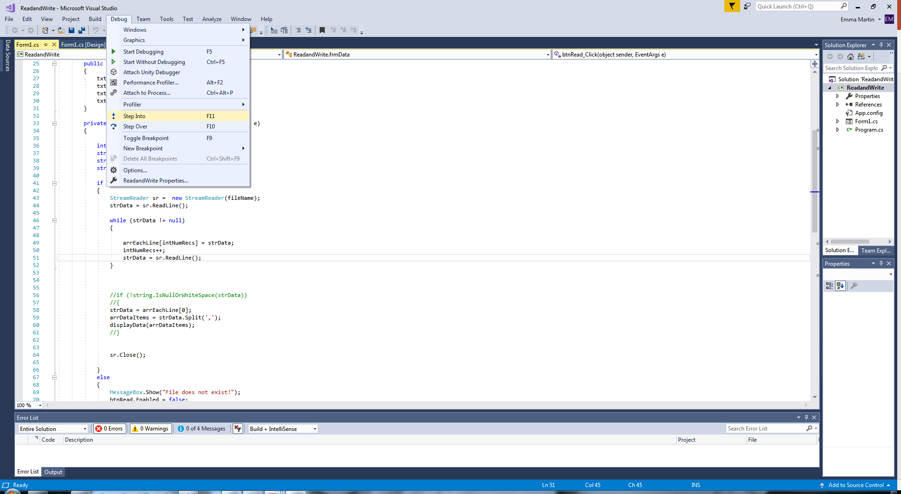
IDE Features
Debug Tools
These allow you to spot and correct programming errors.
A basic feature of debugging is to be able to single-step through the code so that you can see how the variables are changing and how the program flows.
To make it a bit more flexible you can choose to 'step-into' a subroutine or you can 'step-over' it if you know it is working.
In C#,

Slide 7
IDE Features
Debug Tools Cont.
Underlines syntax errors dynamically
Can be corrected before running // saves times
Error Message List
Tells you where errors are and suggests corrections
Crash-dump/post-mortem routine
Shows the state of variables where an error occurs and the program crashes.
Traces
Print-outs of variable values for each statement execution within a program

Slide 8
IDE Features
Debug Tools Cont.
'Breakpoints' can be placed in the code and when that point is reached in the program as it runs, it stops.
This allows you to test the program works up to/at specific points or check variable contents at specific points
In C#,
Another tool is the 'Watch window’ which allows you to view how variables change during running of the program .
You can also tell the program to stop at the instant a variable has a certain value.

Slide 9
IDE Features
Object viewer
Many languages allow you to create 'objects' visually, and these objects have 'attributes' or properties that you can view and alter from this window.
For example some game-making IDEs allow you to create game sprites
Translator
This is either a built-in compiler or a built-in interpreter depending on the language.
The compiler IDE will create the final executable code and also be used within the run-time environment to execute the source code.

Slide 10
IDE Features
Output screen
The runtime environment includes an output screen that lets you see what the program is showing to the user as it runs. This is often another window that pops up outside the main IDE once the runtime starts.
Runtime Environment
This means it allows you to build the project from its files, compile it all and then run it as if the code was running on the target CPU.
It will not run as fast as the real thing, but it really helps complete the project faster and easier.

